Slide 1
Image Compression with Singular Value Decomposition (SVD)
Katrina Sanchez, Sylvia Wei, Alex Hu, Haneef Khan

Slide 2
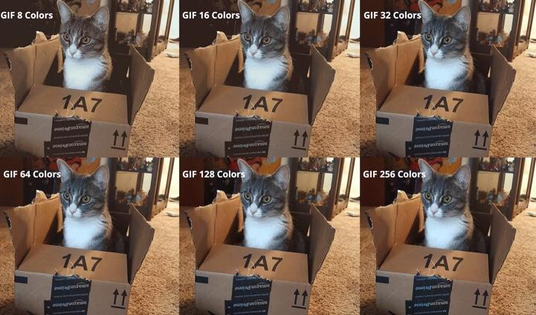
Image Compression
https://www.keycdn.com/support/what-is-image-compression
Image compression is a type of data compression that is used to reduce a digital image’s cost for storage or transmission. This is done by removing and/or grouping together certain parts of an image file. There are two kinds of image compression: lossless and lossy. Lossless compression is a method used to reduce the size of a file maintaining the same quality as before it was compressed (i.e. RAW, PNG) whereas lossy compression is a method that gives a photo an even smaller size at the cost of losing some pieces of the photo (i.e. JPEG, GIF). This relates to singular value decomposition since SVD is frequently used for image compression; the image is treated as a matrix of pixels holding different color values and the least significant pixels are removed.

Slide 3
Usefulness of Image Compression
The most useful part of image compression is apparent when you look at social media websites such as Facebook, Instagram, and Twitter. These websites have millions of users. Each user has a profile picture that takes up space. And digital space is not unlimited. Each of these sites has a recommended size for a profile picture. If you were to go over the suggested size, the website will automatically compress the size of the image to save space. When websites have to hold millions of images, these compressions do make a difference. Not only does compressing images save space, but it also shortens the time it takes for images to be downloaded or uploaded. Common formats for compressing images is JPEG.

Slide 4
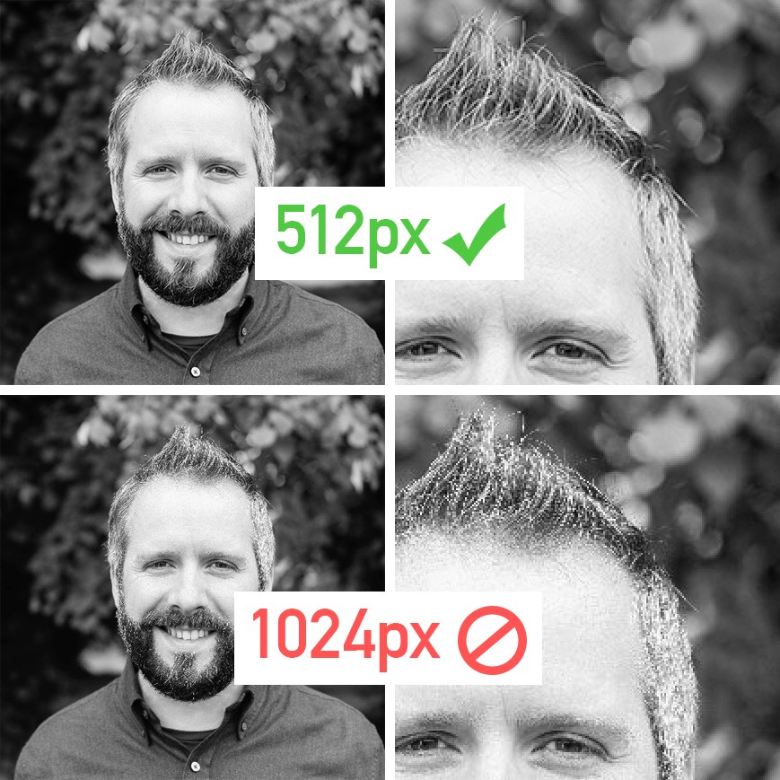
Going Over the Limit
An example of going over the suggested size limit. The image is compressed so that it will fit the recommended size. This will also cause the image to become more pixelated.
https://medium.com/@mountainbeard/welcome-to-compression-hell-heres-why-you-should-never-upload-a-social-media-image-larger-than-c1a184616871

Slide 5
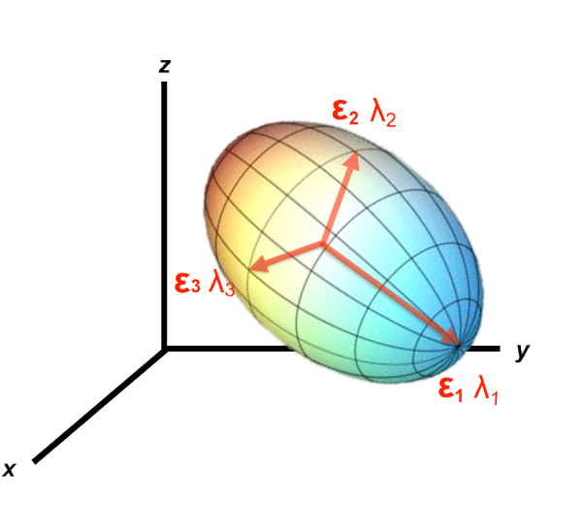

Use of Linear Algebra
A = UΣV^{T}, A: m x n
U: m x m,
Σ: m x n, (sort of) diagonal matrix of singular values in decreasing order
V^{T}: n x n, orthonormal basis of A^{T}A
SVD
Eigenvalues and eigenvectors of A^{T}A: λ → Σ
Compute Gram-Schmidt on each eigenspace → V
U: given formula
mriquestions.com/uploads/3/4/5/7/34572113/_208325_orig.gif
Notes:
Now to get into how linear algebra is actually used to compress images
From this class, we know that A is the matrix being decomposed, that is not necessarily square
The I’th column in U is (1/sigma i) * matrix product of A and Vi
Sigma is the matrix with the singular values of ATA, or the squ, V is …
This image can show us why singular values can be used for compression
Say this ellipsoid is a collection of points in R3, and these points are collected from patients in a COVID-19 vaccine study
In this vaccine study, different observations about the patients were measured, such as their age, weight, and height, and they were plotted on a 3D graph as shown above
Then, intuitively, we can say that the direction of the biggest stretch, represented by lambda 1 or E1, is the characteristic that varies the most along patients
This gives us insight into how to compress images
Say we remove E3, the direction with the least stretch. Sure, we will lose some information, but we will lose less information that if we had removed E1
Now, we understand why the largest singular values correspond to the largest variance, and thus, carry the most information

Slide 6
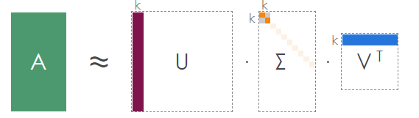
Use of Linear Algebra
Capture maximum variability using least information
Compression: m x n x 3 → (m × k + k + k × n) x 3 = k x (1 + m + n)
timbaumann.info/svd-image-compression-demo
Notes:
We know that the largest eigenvalues of ATA, or the largest singular values, carry the most information about A
So you might say, ok let’s only use the first k singular values from sigma - and that would reduce the amount of information we have to use, but we can actually use what we learned from matrix multiplication to do even better
As the graphic shows, we can actually use only the first k columns of U, and the first k rows of VT, along with obviously the first k singular values of sigma to approximate A
Geometrically, what we are doing is trying to approximate the ellipsoid using only E1 and E2.
Therefore, we are lowering the dimensionality of our data, so that the approximated A is still of size m x n, but is now approximated by k, instead of n, dimensions.
The reason we can multiple like this is because each column in U and each row in VT independently carries information about each singular value
http://timbaumann.info/svd-image-compression-demo/

Slide 7
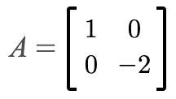
Example computation
Find a singular value decomposition for matrix A i.e. find UΣV^{T}. (Taken from p. 412 #7 in Linear Algebra with Applications)

Slide 8
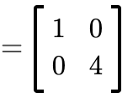
Example computation
Example computation
Step 1: Compute A^{T}A.
A^{T}A =

Slide 9
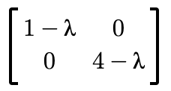
Example computation
Step 2: Find eigenvalues of A^{T}A.
(A^{T}A - λI₂) =
det(A^{T}A - λI₂) = 0
λ₁ = 4; λ₂ = 1

Slide 10
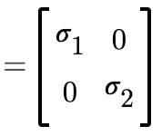
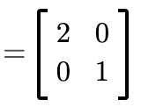
Example computation
Now that we have our eigenvalues, we can solve for the singular values and the matrix Σ.
λ₁ = 4; λ₂ = 1
𝜎₁ = √4 = 2
𝜎₂ = √1 = 1
Σ

Slide 11
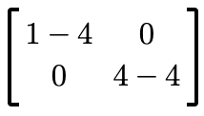

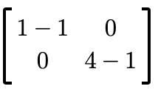

Example computation
Step 3: Compute eigenspaces
ker(A^{T}A - λI₂)
E₄ = ker
=
E₁ = ker
=

Slide 12
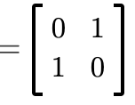
Example computation
In this case, our eigenspaces are also an orthonormal basis so we can solve for the matrix V and its transpose.
E₄
E₁ =
V
= V^{T}
=

Slide 13
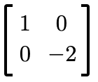

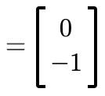
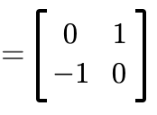

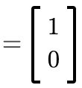
Example computation
Step 4: Solve for the columns of U.
u₁ = 1/2
U
u₂ = 1/1

Slide 14
Example computation
We have found a singular value decomposition for A.

Slide 15

Example of image compression
381 x 600 image (bottom right)
Want to reconstruct the image using only 5% of singular values
k = (0.05)(381) ≈ 20
U’ = 20 leftmost columns of U
Σ’ = 20x20 diagonal matrix of the largest 20 singular values
V^{T}’ = 20 uppermost rows of V^{T}
timbaumann.info/svd-image-compression-demo
https://www.youtube.com/watch?v=mSYgi0KCLv8

Slide 16

Example of image compression
Result of multiplying U’Σ’V^{T}’
Original image
5%

Slide 17
References
Bretscher, O. (2001). 8.3. In Linear algebra with applications (pp. 411-412). Upper Saddle River, NJ: Prentice Hall.
“Image Compression Using SVD in Matlab [Greyscale]”
youtube.com/watch?v=mSYgi0KCLv8
What Is Image Compression? - KeyCDN Support. (n.d.). Retrieved December 06, 2020, from https://www.keycdn.com/support/what-is-image-compression
Baumann, T. (2018). SVD Image Compression Demonstration, timbaumann.info/svd-image-compression-demo/
Contributors, T. (2005, April 05). What is image compression? - Definition from WhatIs.com. Retrieved December 06, 2020, from https://whatis.techtarget.com/definition/ image-compression

Slide 18
Questions?

